Slide 1


More bowling.
More bonding.
Less admin.
Yuuuukkkss!
Member Guide 4.0 · 2 October 2026
Notes:
BAIQ Member Guide 4.0. Opening visual generated for this guide. Brand logo derived from the original BAIQ artwork. Video includes animation and HeyGen catalog impact sounds.

Slide 2
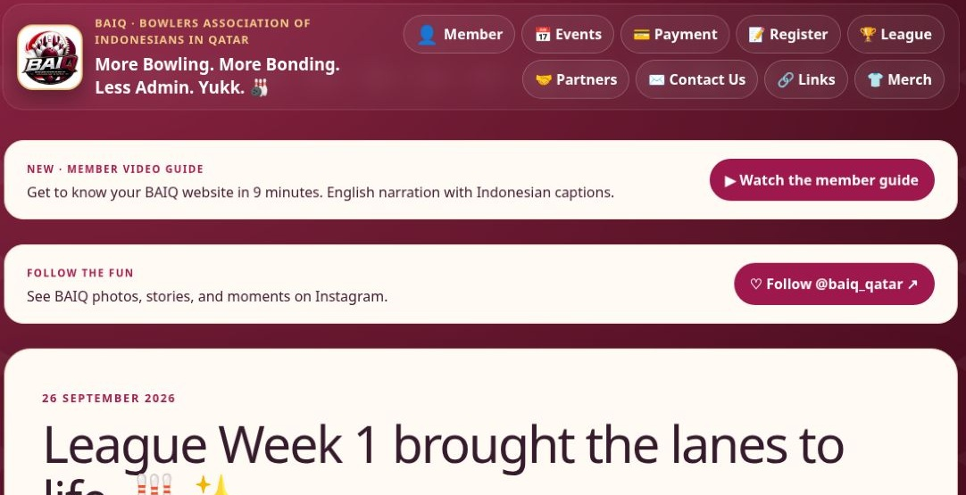
Your BAIQ website
baiq.org
01
Website screenshots
02
Red / blue callouts
03
Guide 4.0 · Website v89
BAIQ.ORG · ACTUAL SCREENSHOT · 2 OCT 2026
Selamat datang, bowlers! Mari melihat website BAIQ dan hal yang digunakan sebelum serta sesudah bermain.
Notes:
Guide 4.0. Website baseline v89. Source: https://baiq.org and baiq.org. Actual public website screenshot taken 2 October 2026.
EN: Welcome, bowlers! Welcome to B A I Q — baeeq! Let’s explore the website and the things you will use before and after a game.
ID: Selamat datang, bowlers! Mari melihat website BAIQ dan hal yang digunakan sebelum serta sesudah bermain.
EN: This is guide version four, made on October second, twenty twenty six, based on website version eighty nine. Website screenshots and labelled account demos now include arrows and circles to help you follow along.
ID: Panduan versi 4, dibuat 2 Oktober 2026 berdasarkan website versi 89. Screenshot website dan demo akun diberi panah serta lingkaran agar mudah diikuti.

Slide 3
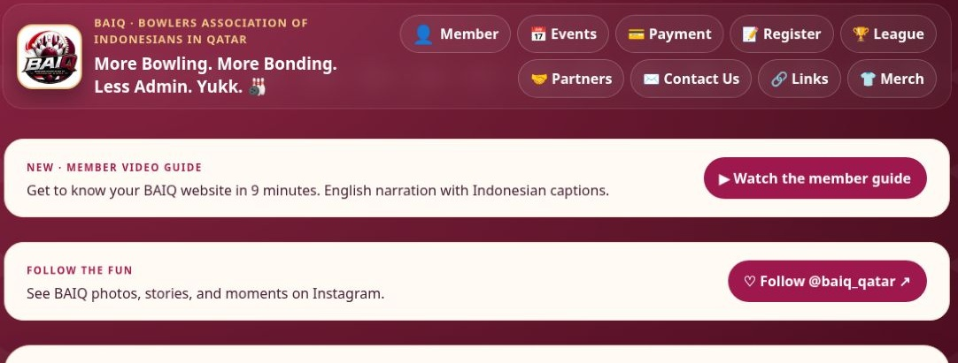
Home and navigation
baiq.org
01
News and event banners on Home
02
Member for your personal account
03
Events, League, Partners and Links
BAIQ.ORG · ACTUAL SCREENSHOT · 2 OCT 2026
Mulai di baiq.org. Beranda menampilkan kabar komunitas, banner acara, dan pembaruan.
Notes:
Guide 4.0. Website baseline v89. Source: https://baiq.org and baiq.org. Actual public website screenshot taken 2 October 2026.
EN: Start at baeeq dot org. The home page brings together community news, event banners, and useful updates.
ID: Mulai di baiq.org. Beranda menampilkan kabar komunitas, banner acara, dan pembaruan.
EN: On your phone, use the navigation buttons to open Member, Events, Payment, League, Partners, and the other sections.
ID: Di ponsel, gunakan tombol navigasi untuk membuka Member, Events, Payment, League, Partners, dan menu lainnya.
EN: Before travelling, check the event date, start time, and location in Events. An older banner may describe a previous session.
ID: Sebelum berangkat, periksa tanggal, jam, dan lokasi di Events. Banner lama mungkin menampilkan sesi sebelumnya.

Slide 4
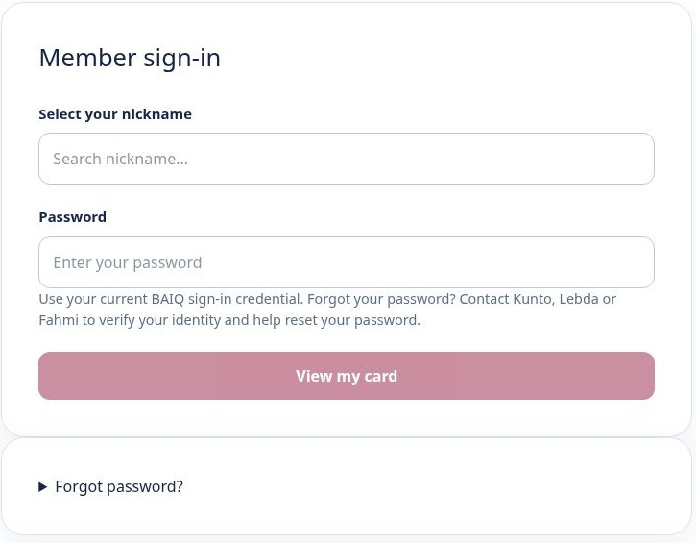
Member sign-in
baiq.org/member
01
Search and select your nickname
02
Enter your current sign-in credential
03
Use recovery assistance if needed
BAIQ.ORG · ACTUAL SCREENSHOT · 2 OCT 2026
Buka Member, cari nickname, pilih nama sendiri, masukkan kredensial saat ini, lalu pilih View my card.
Notes:
Guide 4.0. Website baseline v89. Source: https://baiq.org and baiq.org/member. Actual public website screenshot taken 2 October 2026.
EN: Open Member and search for your nickname. Select your own name, enter your current sign in credential, and choose View my card.
ID: Buka Member, cari nickname, pilih nama sendiri, masukkan kredensial saat ini, lalu pilih View my card.
EN: For first access, follow the instructions from an Officer. Never use another member’s account.
ID: Untuk akses pertama, ikuti petunjuk Officer. Gunakan akun Anda sendiri.
EN: If you forget your password, use the recovery assistance option or contact an Officer. Changing your password is optional, with a minimum of six characters.
ID: Jika lupa password, gunakan bantuan pemulihan atau hubungi Officer. Ganti password bersifat opsional, minimal enam karakter.

Slide 5
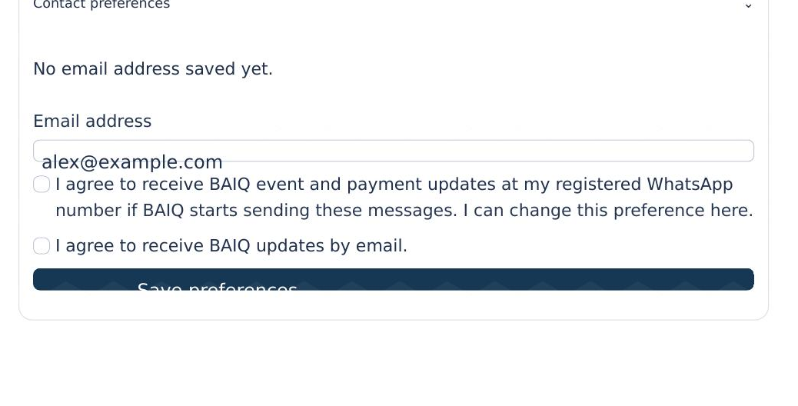
Email updates for existing members
Member / Contact preferences
01
Open Contact preferences
02
Enter your email and choose consent
03
Press Save preferences
WEBSITE COMPONENT · DEMO DATA
Pengingat bagi member lama, terutama yang bergabung sebelum registrasi online: login, buka Contact preferences, dan masukkan email yang aktif.
Notes:
Guide 4.0. Website baseline v89. Source: https://baiq.org and Member / Contact preferences. Rendered original website component with labelled demo data.
EN: First, a reminder for existing members, especially if you joined before online registration. Sign in, open Contact preferences, and enter an email address that you actually use.
ID: Pengingat bagi member lama, terutama yang bergabung sebelum registrasi online: login, buka Contact preferences, dan masukkan email yang aktif.
EN: Choose whether you agree to receive baeeq updates by email. Then press Save preferences. Check that your saved email appears after saving. Typing alone does not save it.
ID: Pilih persetujuan menerima informasi BAIQ melalui email, lalu tekan Save preferences. Pastikan email tersimpan muncul. Mengetik saja belum menyimpan.
EN: This keeps your contact details ready for baeeq email communication. Saving an address does not automatically send every announcement. Automated WhatsApp announcements are not available yet.
ID: Data ini menyiapkan kontak untuk informasi BAIQ melalui email. Menyimpan email tidak otomatis mengirim setiap pengumuman. Pengumuman WhatsApp otomatis belum tersedia.

Slide 6
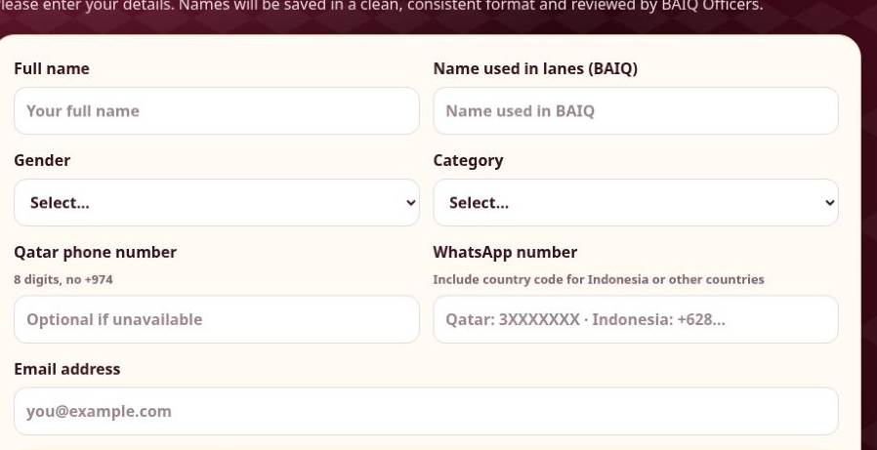
Registration
Home / Register
01
Existing member: no repeat registration
02
New member: Register and await approval
03
Update email inside your account
BAIQ.ORG · ACTUAL SCREENSHOT · 2 OCT 2026
Sudah member? Tidak perlu mendaftar ulang. Member baru menggunakan Register dan menunggu persetujuan Officer. Member lama memperbarui email di akun.
Notes:
Guide 4.0. Website baseline v89. Source: https://baiq.org and Home / Register. Actual public website screenshot taken 2 October 2026.
EN: Already a member? You do not need to register again. Newcomers use Register and wait for Officer approval. Existing members should update their email inside their account.
ID: Sudah member? Tidak perlu mendaftar ulang. Member baru menggunakan Register dan menunggu persetujuan Officer. Member lama memperbarui email di akun.

Slide 7
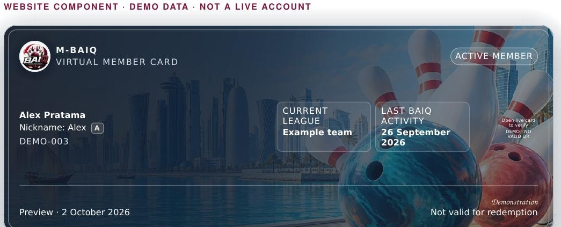
Your virtual member card
Member / My card
01
Your name and membership status
02
Download a PNG copy
03
Show the live card at partners
WEBSITE COMPONENT · DEMO DATA
Kartu virtual menampilkan identitas dan status keanggotaan. Anda dapat mengunduh salinan PNG.
Notes:
Guide 4.0. Website baseline v89. Source: https://baiq.org and Member / My card. Rendered original website component with labelled demo data.
EN: Your virtual card shows your membership identity and status. You can download a P N G copy for your own records.
ID: Kartu virtual menampilkan identitas dan status keanggotaan. Anda dapat mengunduh salinan PNG.
EN: For partner benefits, open the live card on the website. Its Q R code refreshes, so a saved image can expire.
ID: Untuk manfaat partner, buka kartu langsung di website. QR diperbarui berkala, sehingga gambar simpanan dapat kedaluwarsa.
EN: Check your status before requesting an offer. A negative balance makes membership pending and pauses partner discounts until the issue is resolved.
ID: Periksa status sebelum menggunakan promo. Saldo negatif membuat membership Pending dan menunda diskon partner sampai diselesaikan.

Slide 8
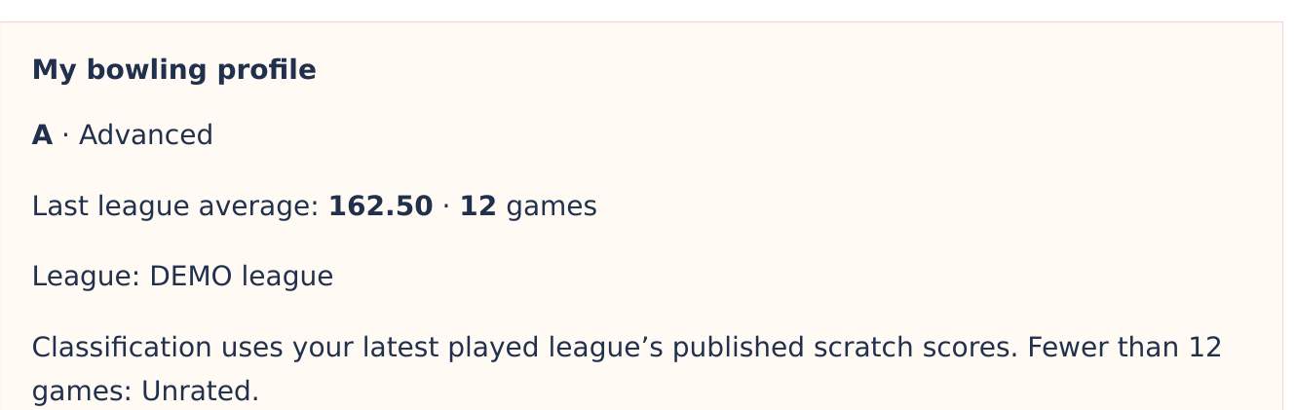
Your bowling profile
Member / My bowling profile
01
Latest played league’s published scores
02
Average and actual game count
03
At least 12 games for a classification
WEBSITE COMPONENT · DEMO DATA
My bowling profile menampilkan rata-rata liga terakhir, jumlah game, dan klasifikasi kemampuan otomatis.
Notes:
Guide 4.0. Website baseline v89. Source: https://baiq.org and Member / My bowling profile. Rendered original website component with labelled demo data.
EN: My bowling profile shows your last league average, game count, and automatic ability classification.
ID: My bowling profile menampilkan rata-rata liga terakhir, jumlah game, dan klasifikasi kemampuan otomatis.
EN: The calculation uses published scratch scores from your latest played league. Training and draft results do not determine this class.
ID: Perhitungan memakai skor scratch resmi dari liga terakhir yang diikuti. Latihan dan hasil draft tidak menentukan kelas ini.
EN: Fewer than twelve games means Unrated. Classes run from C through C plus, B, B plus, A, and A plus, to Star. Open the range table for exact boundaries.
ID: Kurang dari 12 game berarti Unrated. Kelas berurutan C, C+, B, B+, A, A+, lalu Star. Buka tabel untuk batas nilainya.

Slide 9
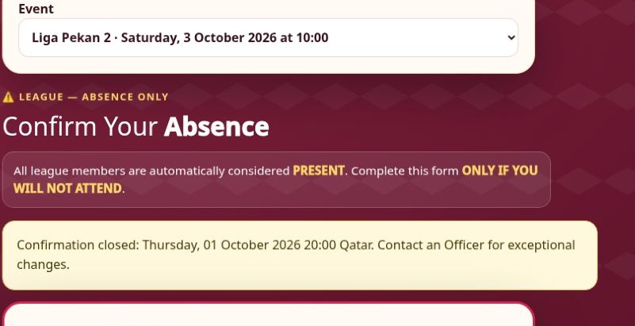
League attendance
Member / Next BAIQ session
01
Rostered members are expected to attend
02
Confirm absence if you cannot come
03
Follow the displayed Qatar-time deadline
BAIQ.ORG · ACTUAL SCREENSHOT · 2 OCT 2026
Untuk liga, anggota roster dianggap hadir. Konfirmasi diperlukan bila tidak bisa datang.
Notes:
Guide 4.0. Website baseline v89. Source: https://baiq.org and Member / Next BAIQ session. Actual public website screenshot taken 2 October 2026.
EN: For league events, rostered members are expected to attend. You only need to confirm when you cannot come.
ID: Untuk liga, anggota roster dianggap hadir. Konfirmasi diperlukan bila tidak bisa datang.
EN: In Next baeeq session or Events, check the selected league and choose Confirm absence before the displayed deadline in Qatar time.
ID: Di Next BAIQ session atau Events, periksa liga yang dipilih dan tekan Confirm absence sebelum tenggat waktu Qatar.
EN: Wait for the saved response message. If your plans change after the deadline, contact an Officer so the actual attendance can be corrected.
ID: Tunggu pesan bahwa jawaban tersimpan. Jika rencana berubah setelah tenggat, hubungi Officer untuk koreksi kehadiran.

Slide 10
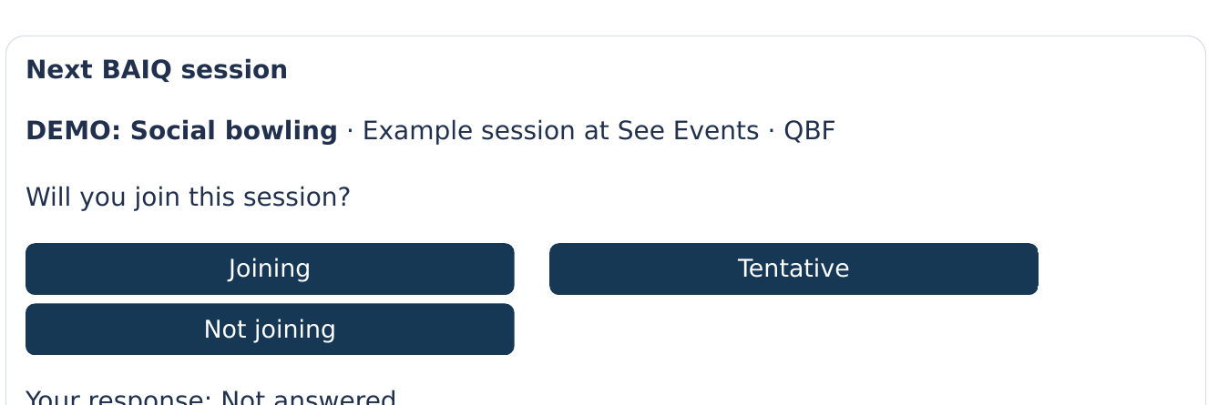
Training and other events
Events / Non-league sessions
01
Choose the correct event
02
Submit your participation response
03
Check payment and venue details
WEBSITE COMPONENT · DEMO DATA
Latihan, social play, dan acara non-liga memakai konfirmasi partisipasi. Pilih acara yang ingin diikuti.
Notes:
Guide 4.0. Website baseline v89. Source: https://baiq.org and Events / Non-league sessions. Rendered original website component with labelled demo data.
EN: Training, social play, and other non league events use participation confirmation. Select the event you intend to join.
ID: Latihan, social play, dan acara non-liga memakai konfirmasi partisipasi. Pilih acara yang ingin diikuti.
EN: Choose Joining, Tentative, or Not joining when those options appear. Check that your response has been saved.
ID: Pilih Joining, Tentative, atau Not joining sesuai pilihan yang tersedia. Pastikan respons tersimpan.
EN: Read the venue, time, and payment instructions for that event. Registering as a member does not automatically reserve a permanent league team place.
ID: Baca lokasi, waktu, dan petunjuk pembayaran acara. Mendaftar member tidak otomatis memberi tempat tetap di tim liga.

Slide 11
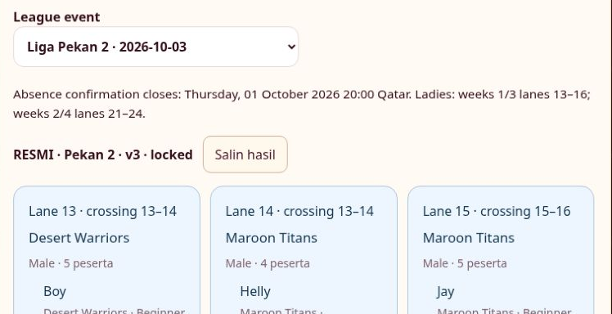
Teams, lanes and late changes
Events / Official lane assignment
01
Read the latest official revision
02
Check your name and lane number
03
Ask an Officer about late changes
BAIQ.ORG · ACTUAL SCREENSHOT · 2 OCT 2026
Setelah undian resmi terbit, periksa nama dan lane. Gunakan revisi terbaru untuk acara Anda.
Notes:
Guide 4.0. Website baseline v89. Source: https://baiq.org and Events / Official lane assignment. Actual public website screenshot taken 2 October 2026.
EN: After the official draw is published, check your name and lane assignment. Use the latest revision shown for your event.
ID: Setelah undian resmi terbit, periksa nama dan lane. Gunakan revisi terbaru untuk acara Anda.
EN: Lanes rotate to help members meet different people. Follow the team shown beside your name, even when a lane contains more than one team.
ID: Lane dirotasi agar member bertemu pemain berbeda. Ikuti tim di samping nama, meskipun satu lane berisi beberapa tim.
EN: For a last minute absence, return, substitute, or additional registered player, contact an Officer. They can record the actual team and lane without asking everyone to confirm again.
ID: Untuk absen, kembali hadir, pengganti, atau peserta tambahan mendadak, hubungi Officer. Tim dan lane aktual dapat dicatat tanpa konfirmasi ulang semua member.

Slide 12
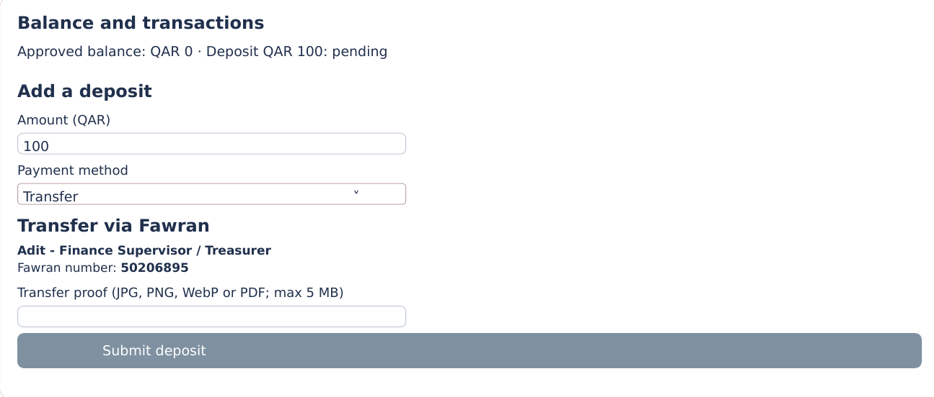
Deposits before bowling
Member / Balance and transactions
01
Check your approved balance
02
Choose an amount and payment method
03
Submit once and wait for approval
WEBSITE COMPONENT · DEMO DATA
Setelah login, buka Balance and transactions. Ini tampilan member dengan data demo. Saldo disetujui muncul di atas Open invoices, Transactions, dan Add a deposit.
Notes:
Guide 4.0. Website baseline v89. Source: https://baiq.org and Member / Balance and transactions. Rendered original website component with labelled demo data.
EN: After signing in, open Balance and transactions. Here is the member page with demonstration data. Your approved balance appears above Open invoices, Transactions, and Add a deposit.
ID: Setelah login, buka Balance and transactions. Ini tampilan member dengan data demo. Saldo disetujui muncul di atas Open invoices, Transactions, dan Add a deposit.
EN: To top up, enter one hundred Qatari riyals, choose Transfer or Cash, and follow the instructions. The current minimum is forty five riyals, with one hundred recommended.
ID: Untuk menambah saldo, isi QAR 100, pilih Transfer atau Cash, lalu ikuti petunjuk. Minimum saat ini QAR 45; rekomendasi QAR 100.
EN: Submitting the form creates a request. A pending deposit does not increase your available balance. Wait for an Officer to approve it before using the money for bowling.
ID: Formulir yang dikirim menjadi pengajuan. Deposit Pending belum menambah saldo tersedia. Tunggu persetujuan Officer sebelum memakai saldo untuk bowling.

Slide 13
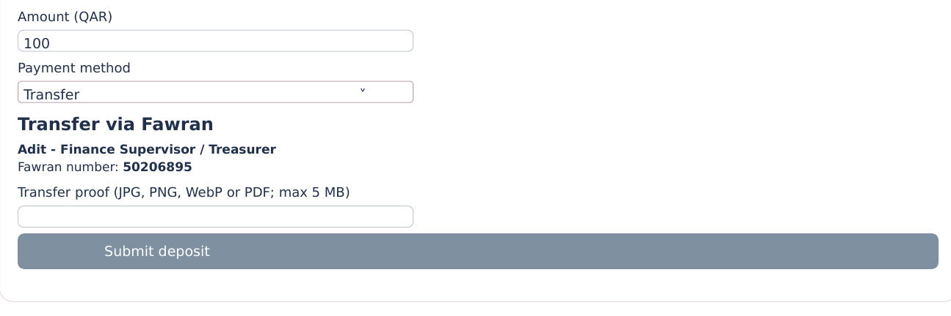
Transfer or cash
Member / Add a deposit
01
Use the receiving details on the page
02
Attach proof for a transfer
03
For cash, identify the receiving Officer
WEBSITE COMPONENT · DEMO DATA
Untuk transfer, ikuti rekening penerima di website. Pada versi ini nomor Fawran Adit adalah 50206895.
Notes:
Guide 4.0. Website baseline v89. Source: https://baiq.org and Member / Add a deposit. Rendered original website component with labelled demo data.
EN: For a transfer, follow the receiving details displayed on the website. This version lists Adit’s Fawran number, five zero two zero six eight nine five.
ID: Untuk transfer, ikuti rekening penerima di website. Pada versi ini nomor Fawran Adit adalah 50206895.
EN: Enter the amount and upload a clear receipt. For cash, hand the money to an Officer and include who received it in your note.
ID: Masukkan jumlah dan unggah bukti yang jelas. Untuk tunai, serahkan uang ke Officer dan tulis siapa penerimanya.
EN: Submit once and wait for approval. If your phone is not working, an Officer can submit for you, and another authorised Officer must approve it.
ID: Kirim sekali dan tunggu persetujuan. Jika ponsel bermasalah, Officer dapat mengajukan untuk Anda dan Officer berwenang lainnya menyetujui.

Slide 14
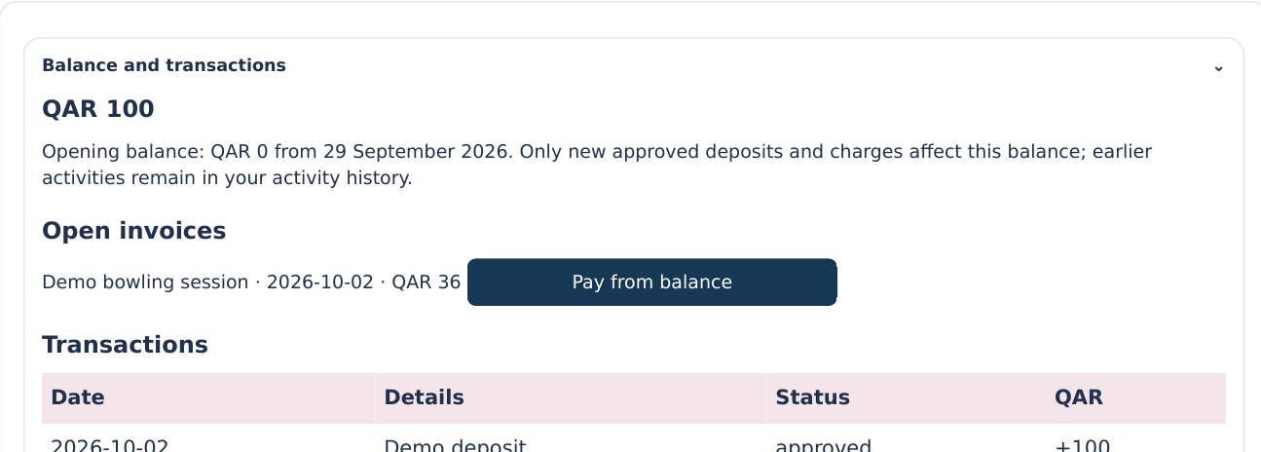
Session payments
Member / Open invoices
01
Approved credit: +QAR 100
02
Pay invoice: −QAR 36
03
Remaining balance: QAR 64
WEBSITE COMPONENT · DEMO DATA
Setelah disetujui, deposit QAR 100 menjadi kredit: uang masuk ke saldo member. Dari saldo awal nol, saldo kini QAR 100.
Notes:
Guide 4.0. Website baseline v89. Source: https://baiq.org and Member / Open invoices. Rendered original website component with labelled demo data.
EN: After approval, a one hundred riyal deposit becomes a credit. Credit means money added to your member balance. Starting from zero, your balance is now one hundred.
ID: Setelah disetujui, deposit QAR 100 menjadi kredit: uang masuk ke saldo member. Dari saldo awal nol, saldo kini QAR 100.
EN: After bowling, check the session and invoice amount. In this example, three games at twelve riyals cost thirty six. Choose Pay from balance, check the confirmation, then confirm.
ID: Setelah bermain, periksa sesi dan jumlah tagihan. Contoh: 3 game × QAR 12 = QAR 36. Pilih Pay from balance, periksa konfirmasi, lalu setujui.
EN: The approved payment is a debit of thirty six riyals. Debit means money used from your balance. One hundred minus thirty six leaves sixty four. These figures are an example, not a real member account.
ID: Pembayaran yang disetujui menjadi debit QAR 36: saldo terpakai. QAR 100 − QAR 36 = QAR 64. Angka ini hanya contoh, bukan akun member sungguhan.
EN: For other methods, follow the payment confirmation flow and wait for verification. If you paid Q B F directly, tell an Officer. That payment should not be submitted as a fresh deposit.
ID: Untuk metode lain, ikuti alur konfirmasi pembayaran dan tunggu verifikasi. Jika membayar langsung ke QBF, beri tahu Officer; jangan ajukan sebagai deposit baru.

Slide 15
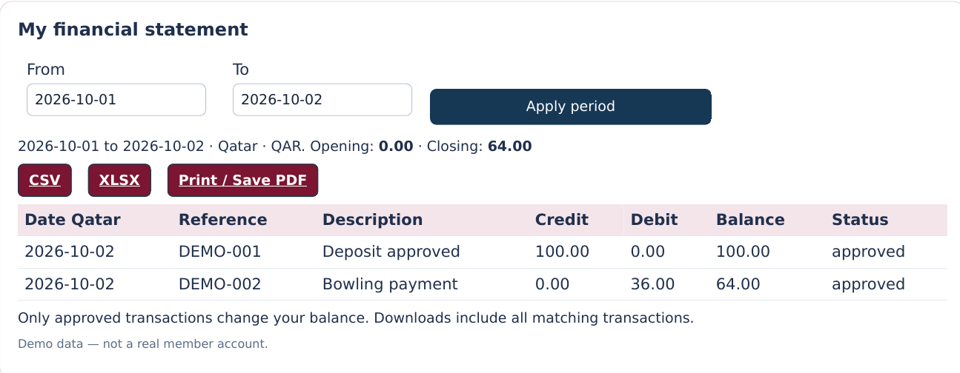
Statements and activity
Member / My financial statement
01
Select a date range
02
Review credits, debits and balance
03
Download CSV, Excel or a printable copy
WEBSITE COMPONENT · DEMO DATA
Buka My financial statement dan pilih periode. Baris pertama demo menunjukkan kredit QAR 100, tanpa debit, dan saldo berjalan QAR 100.
Notes:
Guide 4.0. Website baseline v89. Source: https://baiq.org and Member / My financial statement. Rendered original website component with labelled demo data.
EN: Open My financial statement and choose a date range. In this example, the first row shows a credit of one hundred, no debit, and a running balance of one hundred.
ID: Buka My financial statement dan pilih periode. Baris pertama demo menunjukkan kredit QAR 100, tanpa debit, dan saldo berjalan QAR 100.
EN: The next row shows a debit of thirty six and a closing balance of sixty four. Read the date, reference, description, and status to understand each entry. Only approved transactions change your balance.
ID: Baris berikutnya menunjukkan debit QAR 36 dan saldo akhir QAR 64. Periksa tanggal, referensi, deskripsi, dan status. Hanya transaksi disetujui yang mengubah saldo.
EN: Download C S V or Excel, or choose Print and Save P D F. If a record looks wrong, use Ask an Officer and include its date, amount, and reference. Do not submit the same deposit twice.
ID: Unduh CSV atau Excel, atau pilih Print / Save PDF. Jika ada kekeliruan, gunakan Ask an Officer dengan tanggal, jumlah, dan referensi. Jangan mengajukan deposit yang sama dua kali.

Slide 16
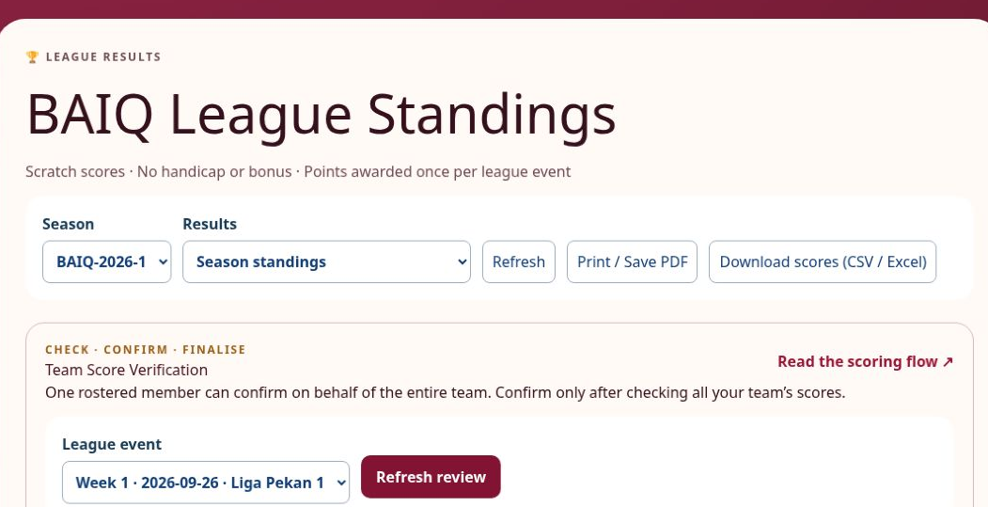
League results
Home / League
01
Choose your season or week
02
View published team and player results
03
Download or print the results
BAIQ.ORG · ACTUAL SCREENSHOT · 2 OCT 2026
Buka League untuk melihat klasemen tim dan skor individu yang sudah diterbitkan. Pilih musim atau pekan.
Notes:
Guide 4.0. Website baseline v89. Source: https://baiq.org and Home / League. Actual public website screenshot taken 2 October 2026.
EN: Open League to follow published team standings and individual scores. Select the season or week you want to review.
ID: Buka League untuk melihat klasemen tim dan skor individu yang sudah diterbitkan. Pilih musim atau pekan.
EN: You can print the results or download the available score files. Published results also feed the league information in your bowling profile.
ID: Anda dapat mencetak hasil atau mengunduh file skor yang tersedia. Hasil resmi juga menjadi sumber informasi liga di profil.
EN: When results are still under review, follow the event’s verification status and deadline instead of treating a draft as final.
ID: Saat hasil masih ditinjau, ikuti status verifikasi dan tenggat acara. Hasil draft belum final.

Slide 17
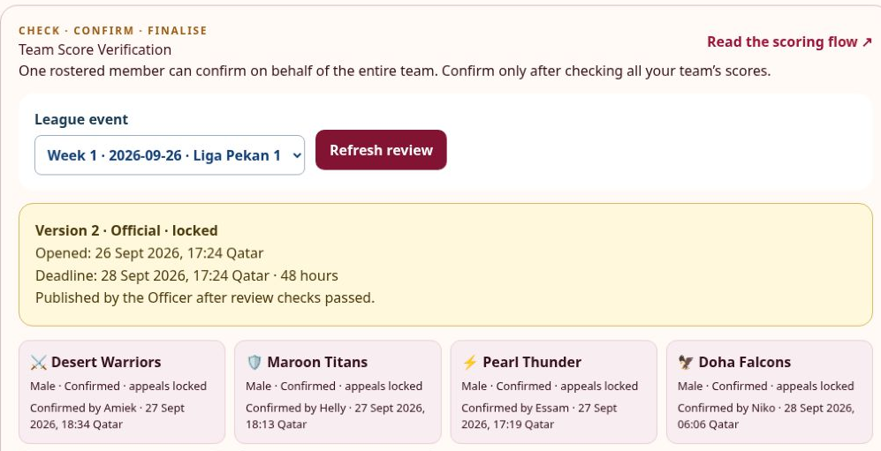
Team score verification
League / Team Score Verification
01
Check every player in your team
02
Compare with the QBF score sheet
03
Confirm only when the whole team is correct
BAIQ.ORG · ACTUAL SCREENSHOT · 2 OCT 2026
Saat peninjauan dibuka, pilih acara di Team Score Verification dan identifikasi diri sebagai anggota tim yang berhak.
Notes:
Guide 4.0. Website baseline v89. Source: https://baiq.org and League / Team Score Verification. Actual public website screenshot taken 2 October 2026.
EN: When the review opens, select your event in Team Score Verification and identify yourself as an eligible team member.
ID: Saat peninjauan dibuka, pilih acara di Team Score Verification dan identifikasi diri sebagai anggota tim yang berhak.
EN: Check every player and game against the Q B F sheet. One eligible member can confirm on behalf of the whole team.
ID: Periksa seluruh pemain dan game dengan lembar QBF. Satu anggota yang berhak dapat mengonfirmasi untuk seluruh tim.
EN: Confirm only after the team has checked everything. Confirmation closes your team’s appeals for that revision, even if the displayed deadline has not passed.
ID: Konfirmasi setelah semua diperiksa. Konfirmasi menutup sanggahan tim untuk revisi itu, meskipun tenggat belum berakhir.

Slide 18
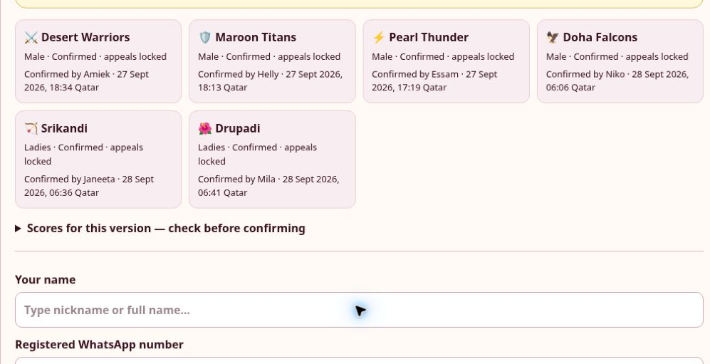
Score corrections
League / Team Score Verification
01
Appeal before confirming
02
State the player, game and correction
03
Attach clear evidence before the deadline
BAIQ.ORG · ACTUAL SCREENSHOT · 2 OCT 2026
Jika skor salah, ajukan sanggahan sebelum konfirmasi tim dan sebelum tenggat yang ditampilkan.
Notes:
Guide 4.0. Website baseline v89. Source: https://baiq.org and League / Team Score Verification. Actual public website screenshot taken 2 October 2026.
EN: If a score is wrong, appeal before confirming the team and before the displayed deadline.
ID: Jika skor salah, ajukan sanggahan sebelum konfirmasi tim dan sebelum tenggat yang ditampilkan.
EN: Name the bowler, game, recorded score, and requested correction. Attach a clear score sheet photo to support the request.
ID: Sebutkan pemain, game, skor tercatat, dan koreksi yang diminta. Lampirkan foto lembar skor yang jelas.
EN: An Officer reviews the evidence. If a revised result appears, read its version and instructions before confirming again.
ID: Officer meninjau bukti. Jika ada hasil revisi, baca versi dan petunjuknya sebelum konfirmasi ulang.

Slide 19
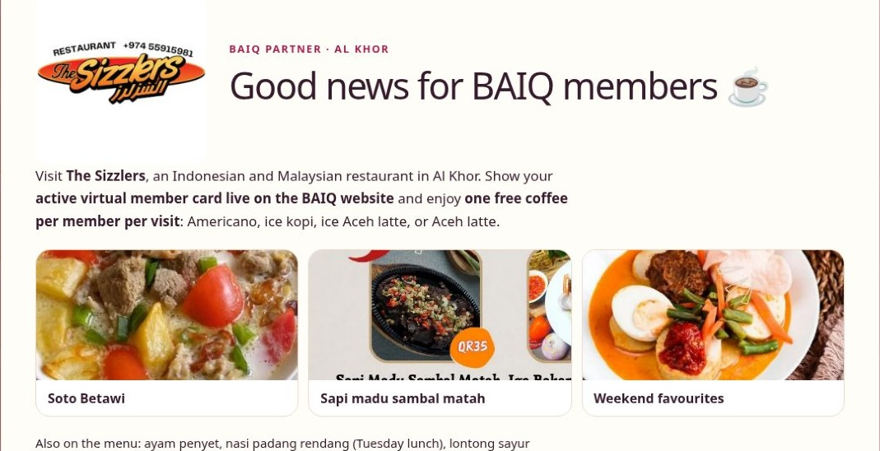
The Sizzlers, Al Khor
Home / Partners
01
Open Partners before visiting
02
One eligible coffee per visit
03
Show your active live card
BAIQ.ORG · ACTUAL SCREENSHOT · 2 OCT 2026
Ini halaman The Sizzlers di website. Di partner Al Khor ini, member aktif dapat menikmati satu kopi yang memenuhi ketentuan per kunjungan.
Notes:
Guide 4.0. Website baseline v89. Source: https://baiq.org and Home / Partners. Actual public website screenshot taken 2 October 2026.
EN: Here is The Sizzlers page on the website. At this Al Khor partner, an active member can enjoy one free eligible coffee per visit.
ID: Ini halaman The Sizzlers di website. Di partner Al Khor ini, member aktif dapat menikmati satu kopi yang memenuhi ketentuan per kunjungan.
EN: Open Partners for the current offer, location and menu. Show your live member card to the restaurant team. Check the listed conditions before ordering.
ID: Buka Partners untuk promo, lokasi, dan menu terbaru. Tunjukkan kartu member live kepada staf. Periksa ketentuan sebelum memesan.

Slide 20
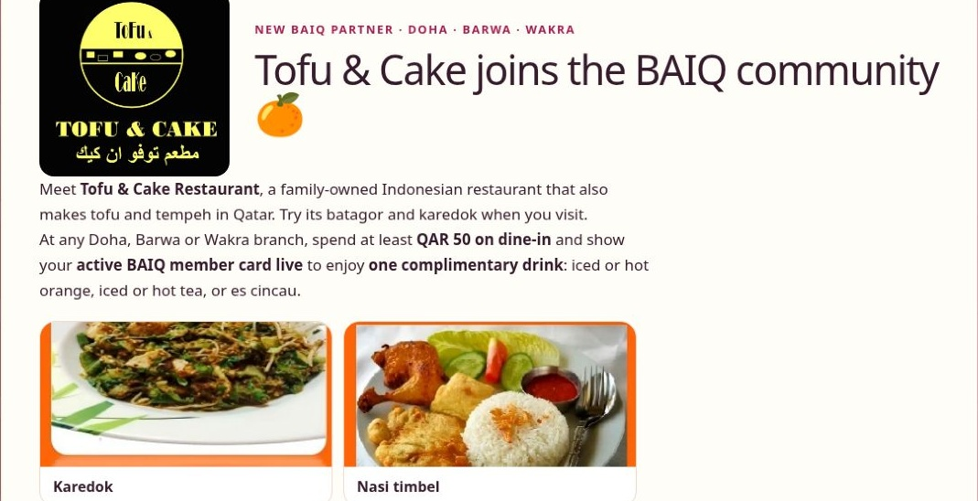
Tofu & Cake Restaurant
Home / Partners
01
Doha, Barwa and Wakra branches
02
Dine in for at least QAR 50
03
One complimentary eligible drink
BAIQ.ORG · ACTUAL SCREENSHOT · 2 OCT 2026
Tofu & Cake juga partner BAIQ. Website mencantumkan cabang Doha, Barwa, dan Wakra. Syarat promo: makan di tempat minimal QAR 50.
Notes:
Guide 4.0. Website baseline v89. Source: https://baiq.org and Home / Partners. Actual public website screenshot taken 2 October 2026.
EN: Tofu and Cake is another baeeq partner. The website currently lists Doha, Barwa and Wakra branches. The offer requires at least fifty Qatari riyals of dine-in spending.
ID: Tofu & Cake juga partner BAIQ. Website mencantumkan cabang Doha, Barwa, dan Wakra. Syarat promo: makan di tempat minimal QAR 50.
EN: Show your active live card for one complimentary eligible drink. Read the current choices and conditions on this page. More partners may be added as the community grows.
ID: Tunjukkan kartu live yang aktif untuk satu minuman sesuai ketentuan. Baca pilihan dan syarat terbaru. Partner lainnya dapat bertambah ke depan.

Slide 21
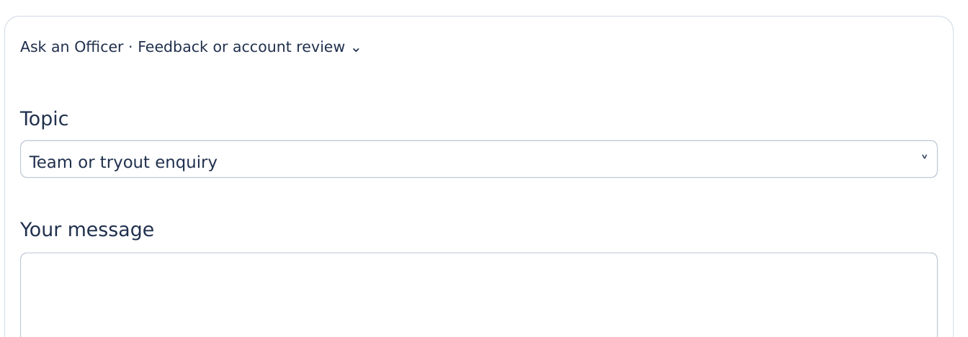
Questions, tryouts and support
Member / Ask an Officer
01
Select the topic that matches your question
02
Give enough detail for a useful answer
03
Use the score appeal flow for score disputes
WEBSITE COMPONENT · DEMO DATA
Gunakan Ask an Officer untuk akun, manfaat partner, saran, atau pertanyaan tim dan tryout. Pilih topik dan jelaskan kebutuhan.
Notes:
Guide 4.0. Website baseline v89. Source: https://baiq.org and Member / Ask an Officer. Rendered original website component with labelled demo data.
EN: Use Ask an Officer for account questions, partner benefits, suggestions, or team and tryout enquiries. Choose a topic and explain what you need.
ID: Gunakan Ask an Officer untuk akun, manfaat partner, saran, atau pertanyaan tim dan tryout. Pilih topik dan jelaskan kebutuhan.
EN: For example, ask about the next suitable tryout and available league places. Officers will explain the next steps.
ID: Contoh: tanyakan tryout berikutnya dan tempat tim liga yang tersedia. Officer akan menjelaskan langkah selanjutnya.
EN: If you cannot sign in, use Contact Us or contact an Officer in the official group. Score disputes should use Team Score Verification.
ID: Jika belum bisa login, gunakan Contact Us atau hubungi Officer di grup resmi. Sanggahan skor menggunakan Team Score Verification.

Slide 22
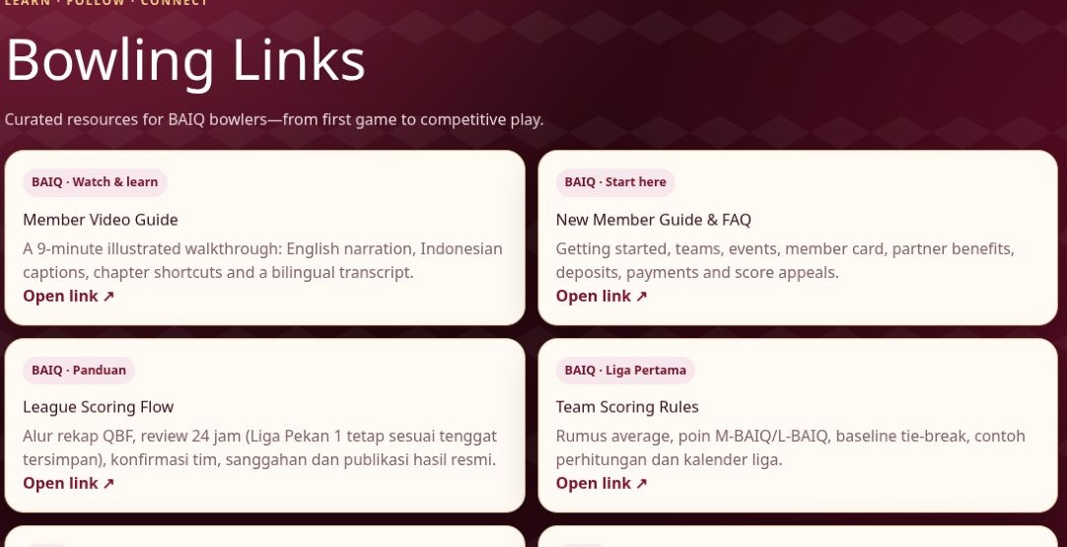
News, links and merchandise
Home / Links / Merch
01
Read community news and useful guides
02
Share event photos only with consent
03
Merchandise currently says Coming soon
BAIQ.ORG · ACTUAL SCREENSHOT · 2 OCT 2026
Jelajahi News, Links, dan New member guide untuk informasi penting, FAQ, dan alur penilaian skor.
Notes:
Guide 4.0. Website baseline v89. Source: https://baiq.org and Home / Links / Merch. Actual public website screenshot taken 2 October 2026.
EN: Explore News, Links, and the New member guide for useful information. The guide includes frequently asked questions and the scoring workflow.
ID: Jelajahi News, Links, dan New member guide untuk informasi penting, FAQ, dan alur penilaian skor.
EN: Where the session form offers photo sharing, uploading photos is optional. Give consent only if you agree that Officers may review and use them for community posts.
ID: Jika formulir sesi menawarkan berbagi foto, unggahan bersifat opsional. Beri persetujuan bila foto boleh ditinjau dan digunakan untuk konten komunitas.
EN: Merchandise currently shows Coming soon. Watch that page for future announcements, and ask an Officer about availability before making any purchase.
ID: Merchandise saat ini bertuliskan Coming soon. Pantau pengumuman berikutnya dan tanyakan ketersediaan sebelum membeli.

Slide 23
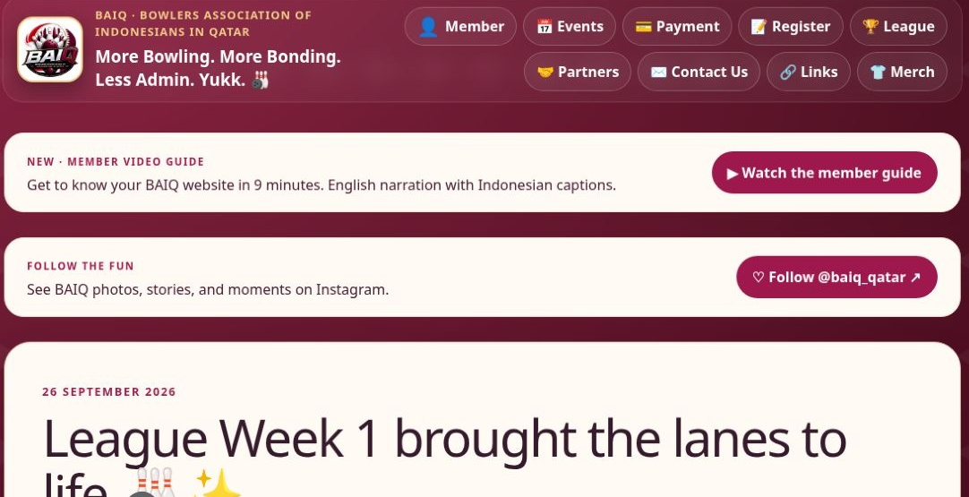
Your next visit
baiq.org
01
Before: check the event and your balance
02
At QBF: check the latest lane assignment
03
After: review the invoice and team scores
BAIQ.ORG · ACTUAL SCREENSHOT · 2 OCT 2026
Sebelum sesi berikutnya, login, periksa acara, dan cek saldo. Di QBF, lihat penempatan lane terbaru.
Notes:
Guide 4.0. Website baseline v89. Source: https://baiq.org and baiq.org. Actual public website screenshot taken 2 October 2026.
EN: Before the next session, sign in, check the event, and review your balance. At Q B F, check the latest lane assignment.
ID: Sebelum sesi berikutnya, login, periksa acara, dan cek saldo. Di QBF, lihat penempatan lane terbaru.
EN: After bowling, review your invoice and help your team verify the scores. Keep your email and contact preferences up to date.
ID: Setelah bermain, periksa tagihan dan bantu tim memverifikasi skor. Perbarui email serta preferensi kontak.
EN: Thank you for being part of baeeq. We can now open the website together and answer your questions.
ID: Terima kasih telah menjadi bagian BAIQ. Sekarang kita dapat membuka website bersama dan melanjutkan tanya jawab.

